Slide 1
Pakistan in Geo political context

Slide 2
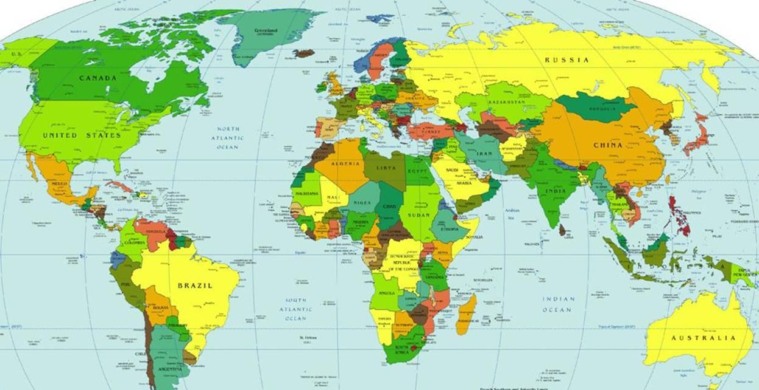

Slide 3
Difference between Geo-politics & Geo- Strategy
Geo politics
Concept of plurality rather than singularity
geographical settings
Political process National + International

Slide 4
Geo strategic
Direction for State’s foreign policy
Military power
&
diplomatic activity

Slide 5
Foreign policy
Determinants of foreign policy
responsible factors
Determinants of Pakistan’s Foreign policy
Foreign Relations
International relations

Slide 6
`
Other concepts
Neo vassal status Junior ally
Proxy wars Utilization of external strife
Deadly triangles
Pakistan
USA China

Slide 7
Zero Sum world
The mood will be tensed; get used to it
Signaling
Negotiated settlement
Buffer state
states that great powers have an interest in preserving
Full spectrum diplomacy
Hard power, soft power, smart power
Military globalization
Nuclear umbrella

Slide 8
Pakistan’s Geo political context
Alliances
NATO (North Atlantic Treaty Organization), 1949
SEATO (South East Asian Treaty Organization), 1953
CENTO ( Central Treaty Organization), 1955
Effects of Crucial Geo political location
Economic benefits
foreign fighters
influence of ISI
Strategy to cater India and Afghanistan

Slide 9
‘Prisoner of Geography’
Pakistan, a new vassal state
India
proven fear in East Pakistan
Kashmir controversy
Afghanistan
‘Greater Pakhtunistan’ controversy
Tribal areas of Pakistan
After proxy wars, 1979, 2001

Slide 10
Geo strategic importance
Cross road of World trade
Reduce Indian hegemony
Part of ‘ The Great game’
Nuclear power program
Importance for Muslim world
China---- to be next super power
Effects
Part of deadly triangles

